Slide 1

User Stories
Adapted from slides by Mike Cohn

Slide 2
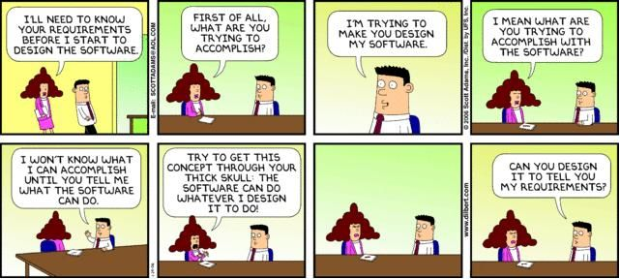
What Problem Do Stories Address?
Software requirements are a communication problem
Those who want the software must communicate with those who will build it

Slide 3
Balance is Critical
Business interests
Functionality defined by ambiguous natural languages
Unrealistic timelines are set
Features are set without understanding of how realistic they are
Technical interests
Functionality defined by technical jargon
Well documented code
Fully tested code
Feature bloat
developers lose the opportunity to learn from listening

Slide 4

Resource Allocation
Projects fail when the problem resources are poorly allocated
Communication is necessary so that resource allocation becomes a shared problem
Business team and technical team speak different languages
Need a method to communicate so both sides can agree on resource allocation, leading to project success!

Slide 5
Responsibility for Resource Allocation
If developers are responsible
May trade quality for additional features
May only partially implement a feature
May solely make decisions that should involve the business
If the business is responsible
Lengthy upfront requirements negotiation and signoff
Features are progressively dropped as the deadline nears

Slide 6
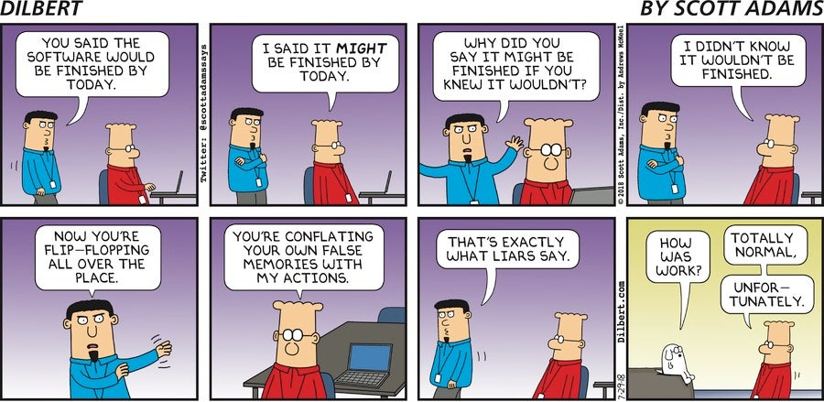
Imperfect Schedules
We cannot perfectly predict a software schedule
As users see the software, they come up with new ideas
Too many intangibles
Developers have a notoriously hard time estimating
If we can’t perfectly predict a schedule, we can’t perfectly say what will be delivered

Slide 7
So, what do we do?
We make decisions based on the information we have, but we do it often
Rather than making one all-encompassing set of decisions, we spread decision making across the project
This is where user stories come in

Slide 8
What Are User Stories?

Slide 9
The Three C’s
Card
Stories are traditionally written on note cards
Cards may be annotated with estimates, notes, etc
Conversation
Details behind the story come out during conversations with product owner
Confirmation
Acceptance tests confirm a story was coded correctly

Slide 10
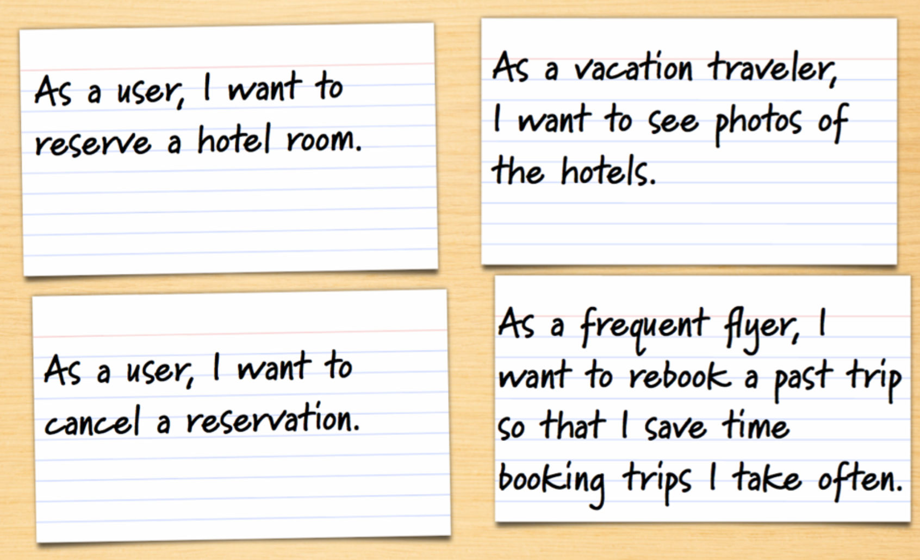
Samples from a Travel Website

Slide 11
Where are the details?
As a user, I can cancel a reservation
Does the user get a full or partial refund?
Is the refund to her credit card or is it site credit?
How far ahead must the reservation be cancelled?
Is that the same for all hotels?
For all site visitors? Can frequent travelers cancel later?
Is a confirmation provided to the user?
How?

Slide 12
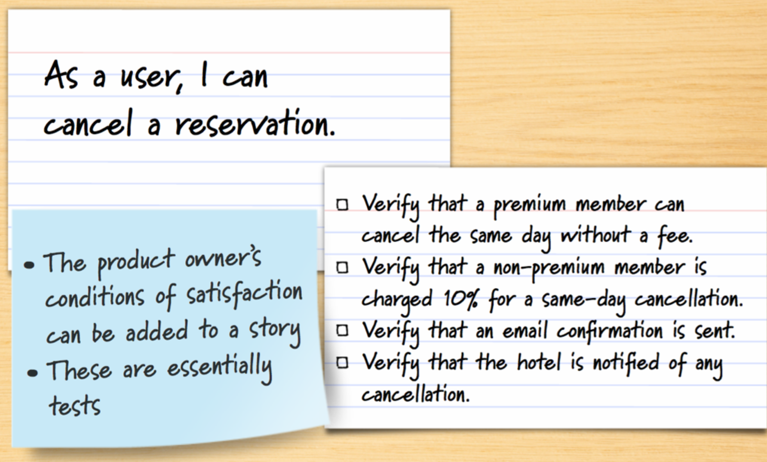
Details as Conditions of Satisfaction

Slide 13
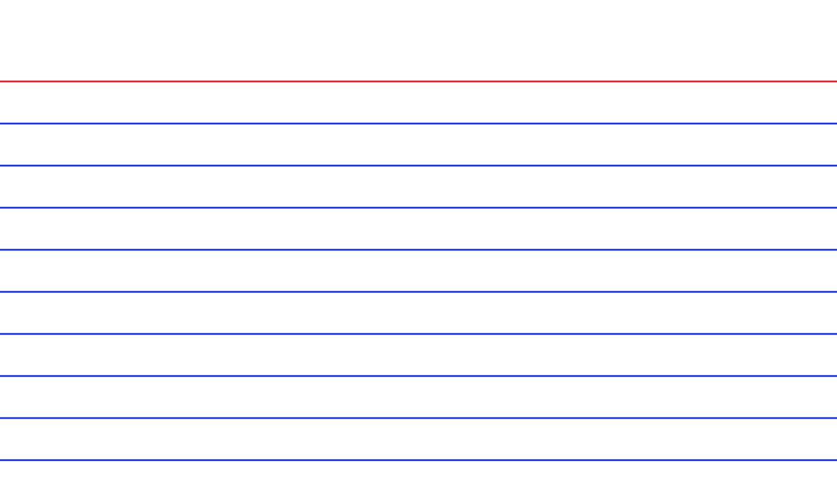
Details added in Smaller Sub-stories
As a premium site member, I can cancel a reservation up to the last minute
As a user, I can cancel a reservation
As a site visitor, I am emailed a confirmation of any cancelled reservation

Slide 14
Techniques can be Combined
These approaches are not mutually exclusive
Write stories at an appropriate level
By the time it’s implemented, each story will have conditions of satisfaction associated with it

Slide 15
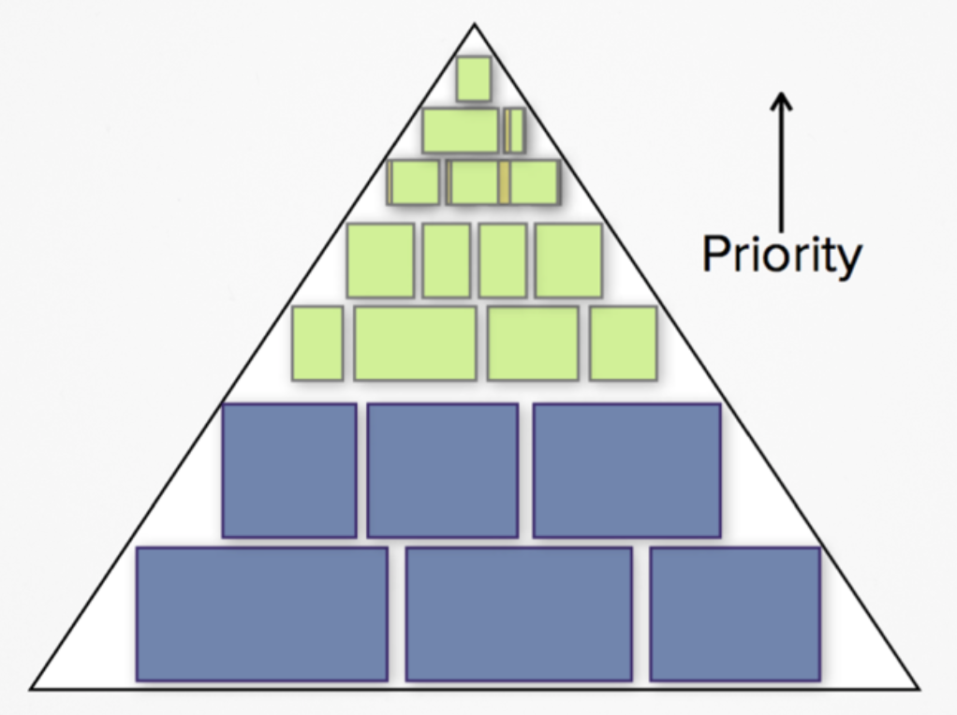
The Product Backlog Iceberg
Theme: a collection of related user stories
Epic: a large user story

Slide 16
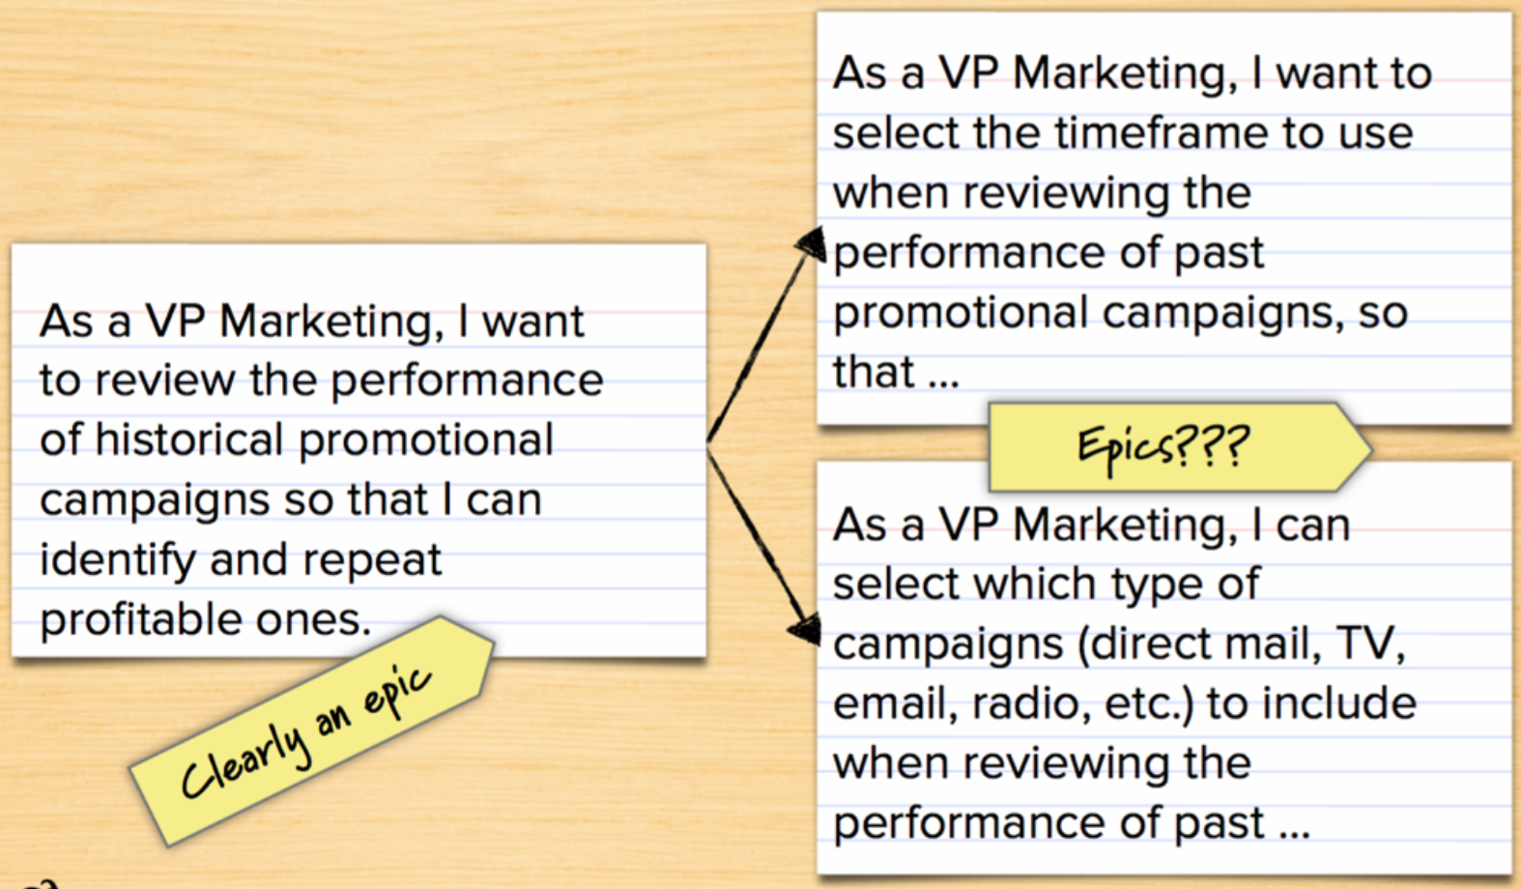
An Example

Slide 17
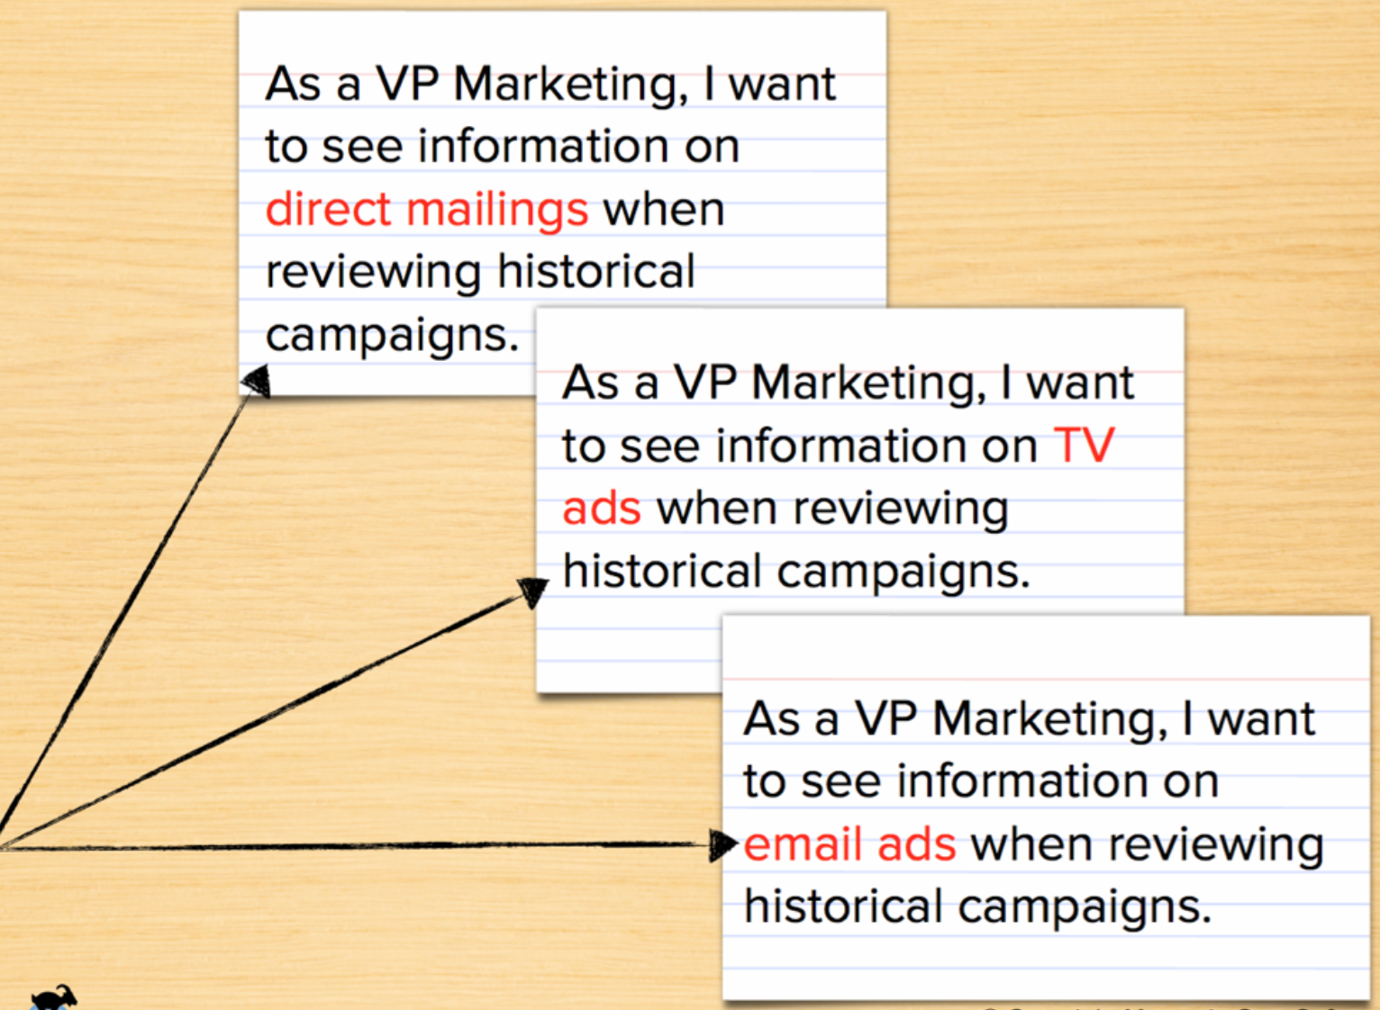

Slide 18
Writing User Stories

Slide 19
Exercise - Logging In
See how many user stories you can write about logging in
Examples:
As a registered user, I am required to login so that I can access the system
As a forgetful user, I can request a password reminder so that I can log in if I forget mine
“As a <user role>, I <want/need/can/etc> <goal> so that <reason>”

Slide 20
Story-writing Workshop
Includes whole team plus possibly some external stakeholders
Typically not done every sprint
Brainstorm to generate stories
Goal is to write as many stories as possible
No prioritization at this point

Slide 21
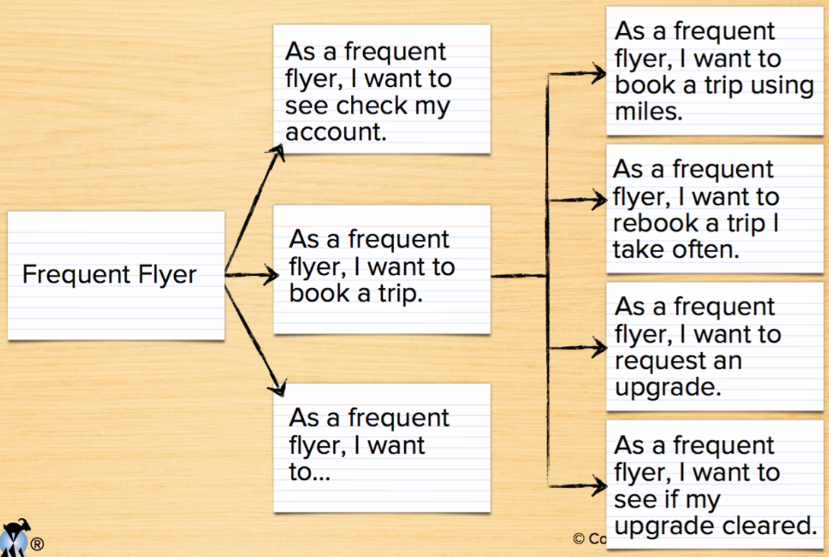
Start with Epics and Iterate

Slide 22
Why User Stories?

Slide 23
So why User Stories?
Shift focus from writing to talking
If requirements are written down, at best you’ll get what was written
“You built what I asked for, but it’s not what I need”
Words are imprecise
“Entree comes with soup or salad and bread”
(Soup or Salad) and Bread
(Soup) or (Salad and Bread)

Slide 24
Examples
“The user can enter a name. It can be 127 characters”
Must the user enter a name?
Can it be other than 127 characters?
“The system should prominently display a warning message whenever the user enters invalid data”
What does “should” mean?
What does prominently display mean?
Is invalid data defined elsewhere?

Slide 25
Additional Reasons
Stories are understandable
Developers and customers understand them
People are better able to remember events if they are organized into stories
Support and encourage iterative development
Can easily start with epics and disaggregate closer to development time

Slide 26
Yet more Reasons
Stories are the right size for planning
Stories support opportunistic development
We design solutions by moving opportunistically between top-down and bottom-up approaches
Stories support participatory design

Slide 27
Most Importantly
Don’t forget the purpose
The story text we write on cards is less important than the conversations we have

Slide 28


Questions?

